Slide 1
Time plan - 2
1-2 minutes for introduction and contents
7 minutes for System showcase and description (Concept)
3 implementation (Concept)
6 min Theoretical positioning (Scoping)
3 min Evaluation methodology (
2 min results
5 min discussion
1 min ending
1-2 minutes for introduction and

Slide 2
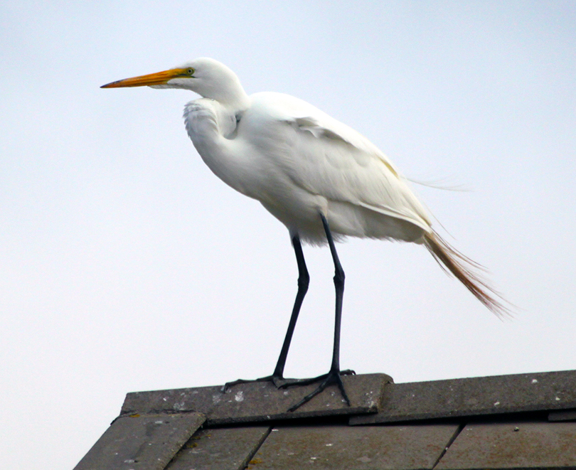
Urban Echoes
Creating Engagement With Urban Avian Wildlife Through Aesthetic Experience

Slide 3
Table of contents
Urban Echoes Demo and system description
Related work
Evaluation Methodology
Results
Discussion
Summary
References

Slide 4
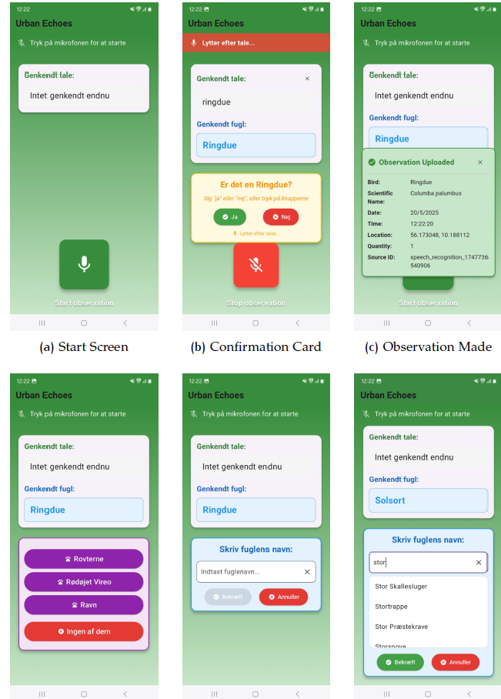
System description
Audio based map experience
Listener
Observer
Use scenario – Live demo

Slide 5
Related work
Present state of the art and assure me that you
scoped the project right
• Make me sure that what you present is not
something hundreds of other people already
have done
• Theoretically well backed up
• Ethnography tells it is relevant
Research trough design
Krogh et al.
SCHI and SID
Blevis
Aesthetic interaction design
Petersen et al.
(maybe Gaver and mynaturewatch)
Commercial examples
Merlin Bird ID
iNaturalist
Noticing, ontological design, Futurering
Rosen et al.
Lawton et al.

Slide 6
Evaluation Methodology
Dairy study
11 participants

Slide 7
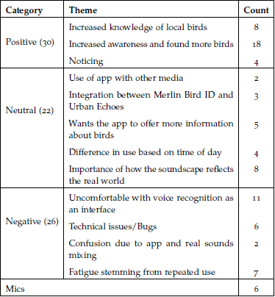
Results
Created engagement and increased knowledge
Speech interface
Alignment
Information
Fatigue

Slide 8
Discussion
What can be done to increase Alignment?
Future work
Educational
Citizen science

Slide 9
Summery

Slide 10
References

